Slide 1
Software Design Patterns Introduction to the Observer Pattern
Muhammad Asaduzzaman
School of Computer Science, University of Windsor

Slide 2
Topics

Slide 3
Topics
Importance

Slide 4
Topics
Importance
Problem Description

Slide 5
Topics
Importance
Problem Description
Solution

Slide 6
Topics
Importance
Problem Description
Solution
Using Observer Pattern

Slide 7
Topics
Importance
Problem Description
Solution
Using Observer Pattern
Implementation

Slide 8
Learning Outcomes
Understand the purpose of design patterns
Understand the necessity of dealing with changes
Describe the context of using the observer pattern
Learn how to use the observer pattern in Java

Slide 9
Why should we learn design patterns?

Slide 10

Why should we learn design patterns?
“Each pattern describes a problem which occurs over and over again in our environment, and then describes the core of the solution to that problem in such a way that that you can use this solution a million times over, without ever doing it the same way twice”
-Christopher Alexander

Slide 11

Why should we learn design patterns?
“Each pattern describes a problem which occurs over and over again in our environment, and then describes the core of the solution to that problem in such a way that that you can use this solution a million times over, without ever doing it the same way twice”
-Christopher Alexander

Slide 12

Why should we learn design patterns?
“Each pattern describes a problem which occurs over and over again in our environment, and then describes the core of the solution to that problem in such a way that that you can use this solution a million times over, without ever doing it the same way twice”
-Christopher Alexander

Slide 13

Why should we learn design patterns?
“Each pattern describes a problem which occurs over and over again in our environment, and then describes the core of the solution to that problem in such a way that that you can use this solution a million times over, without ever doing it the same way twice”
-Christopher Alexander

Slide 14
Why are design patterns important?

Slide 15

Why are design patterns important?

Slide 16

Why are design patterns important?

Slide 17

Why are design patterns important?

Slide 18
A Catalog of Design Patterns
Creational Patterns (abstracting the object-instantiation process)
Factory Method Abstract Factory Singleton
Builder Prototype

Slide 19
A Catalog of Design Patterns
Creational Patterns (abstracting the object-instantiation process)
Factory Method Abstract Factory Singleton
Builder Prototype
Structural Patterns (how objects/classes can be combined)
Adapter Bridge Composite
Decorator Facade Flyweight
Proxy

Slide 20
A Catalog of Design Patterns
Creational Patterns (abstracting the object-instantiation process)
Factory Method Abstract Factory Singleton
Builder Prototype
Structural Patterns (how objects/classes can be combined)
Adapter Bridge Composite
Decorator Facade Flyweight
Proxy
Behavioral Patterns (communication between objects)
Command Interpreter Iterator
Mediator Observer State
Strategy Chain of Responsibility Visitor
Template Method

Slide 21
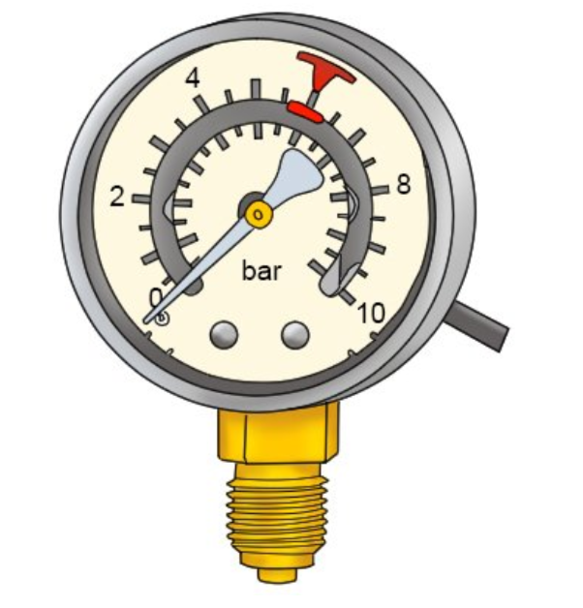



Problem Description
Pressure Sensor
Temperature
Sensor
Weather
Station
Humidity Sensor

Slide 22

Problem Description
Pressure Sensor
Temperature
Sensor
Weather
Data
Object
Weather
Station
Humidity Sensor

Slide 23

Problem Description
Pressure Sensor
Display 1
Temperature
Sensor
Weather
Data
Object
Weather
Station
Display 2
Humidity Sensor
Display 3

Slide 24
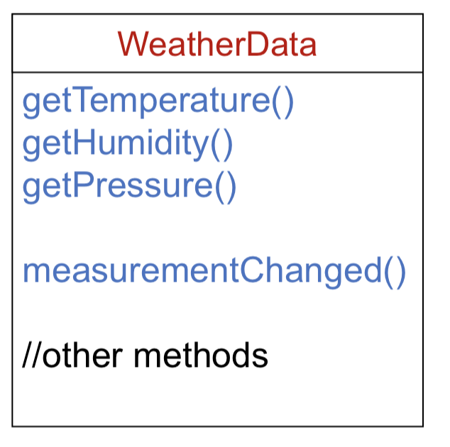
Weather Data Object

Slide 25
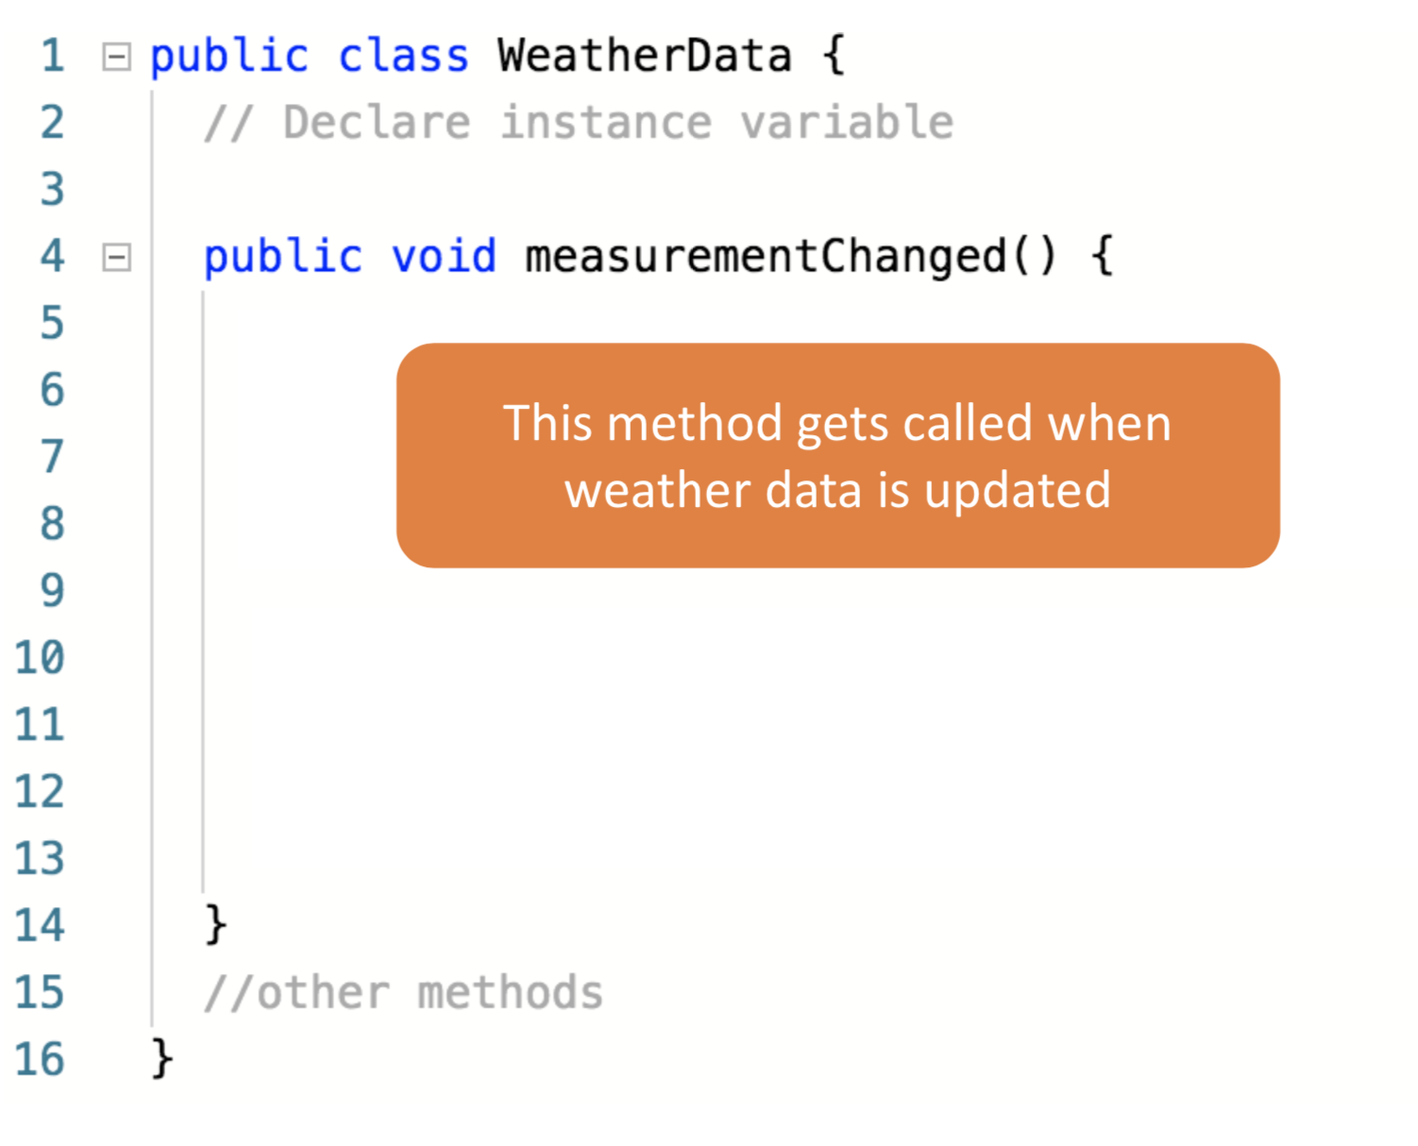
Weather Data Object

Slide 26
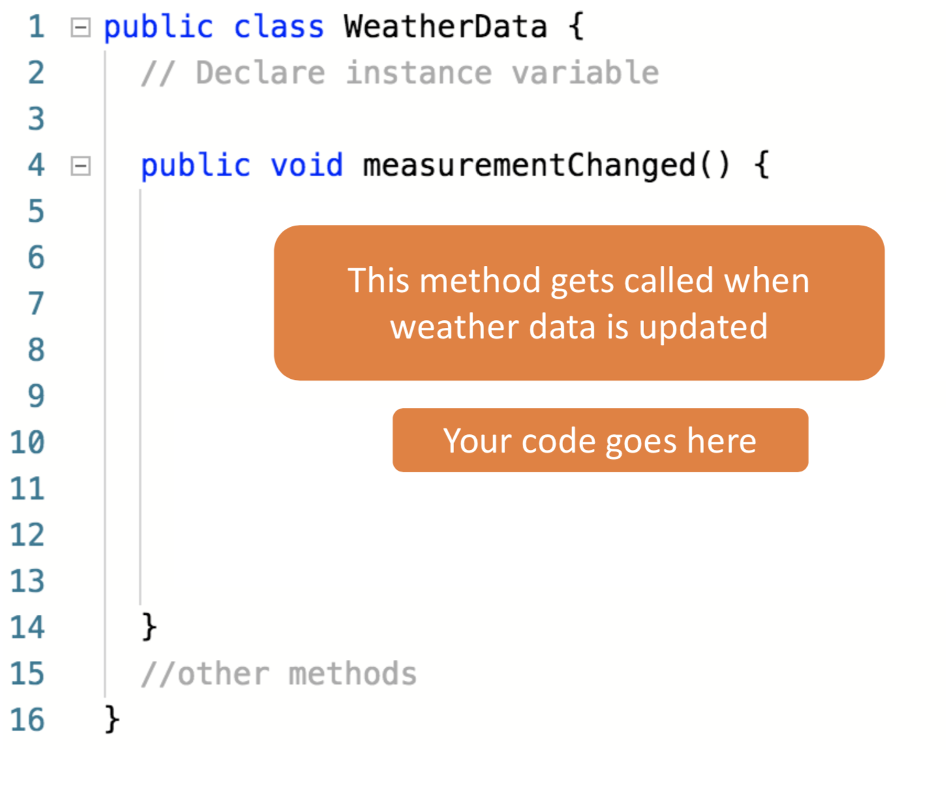
Weather Data Object

Slide 27
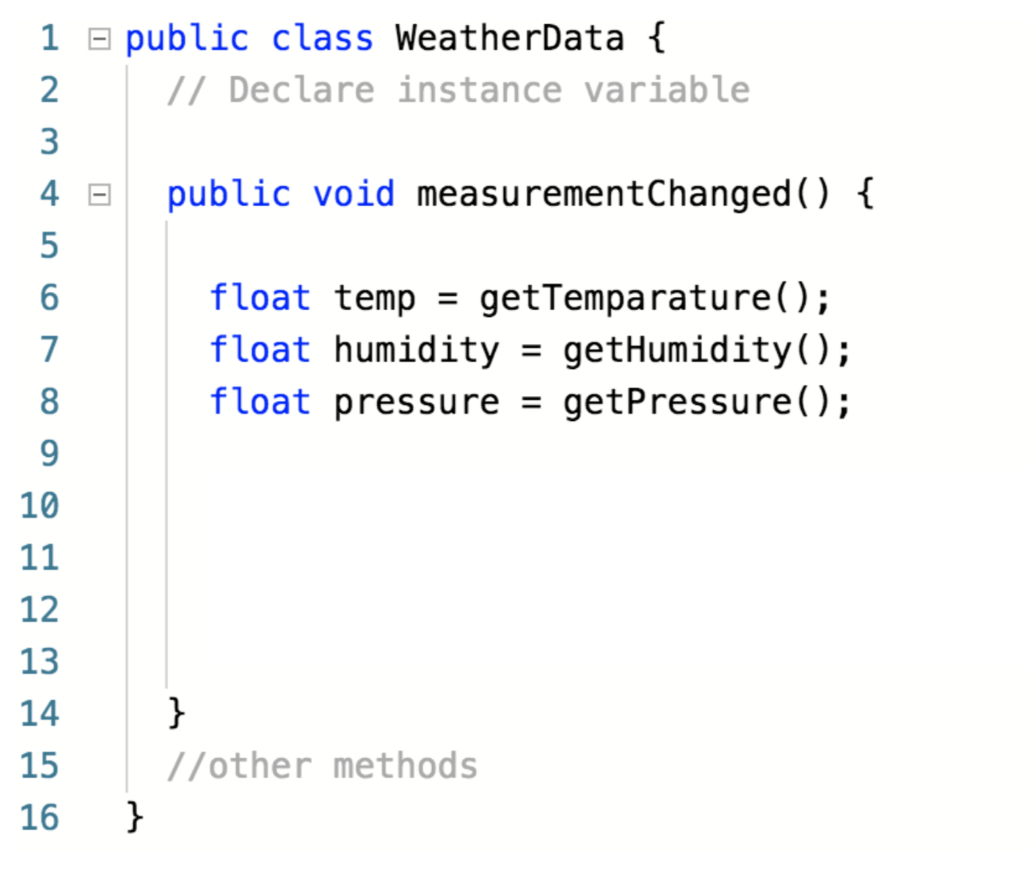
Weather Data Object

Slide 28
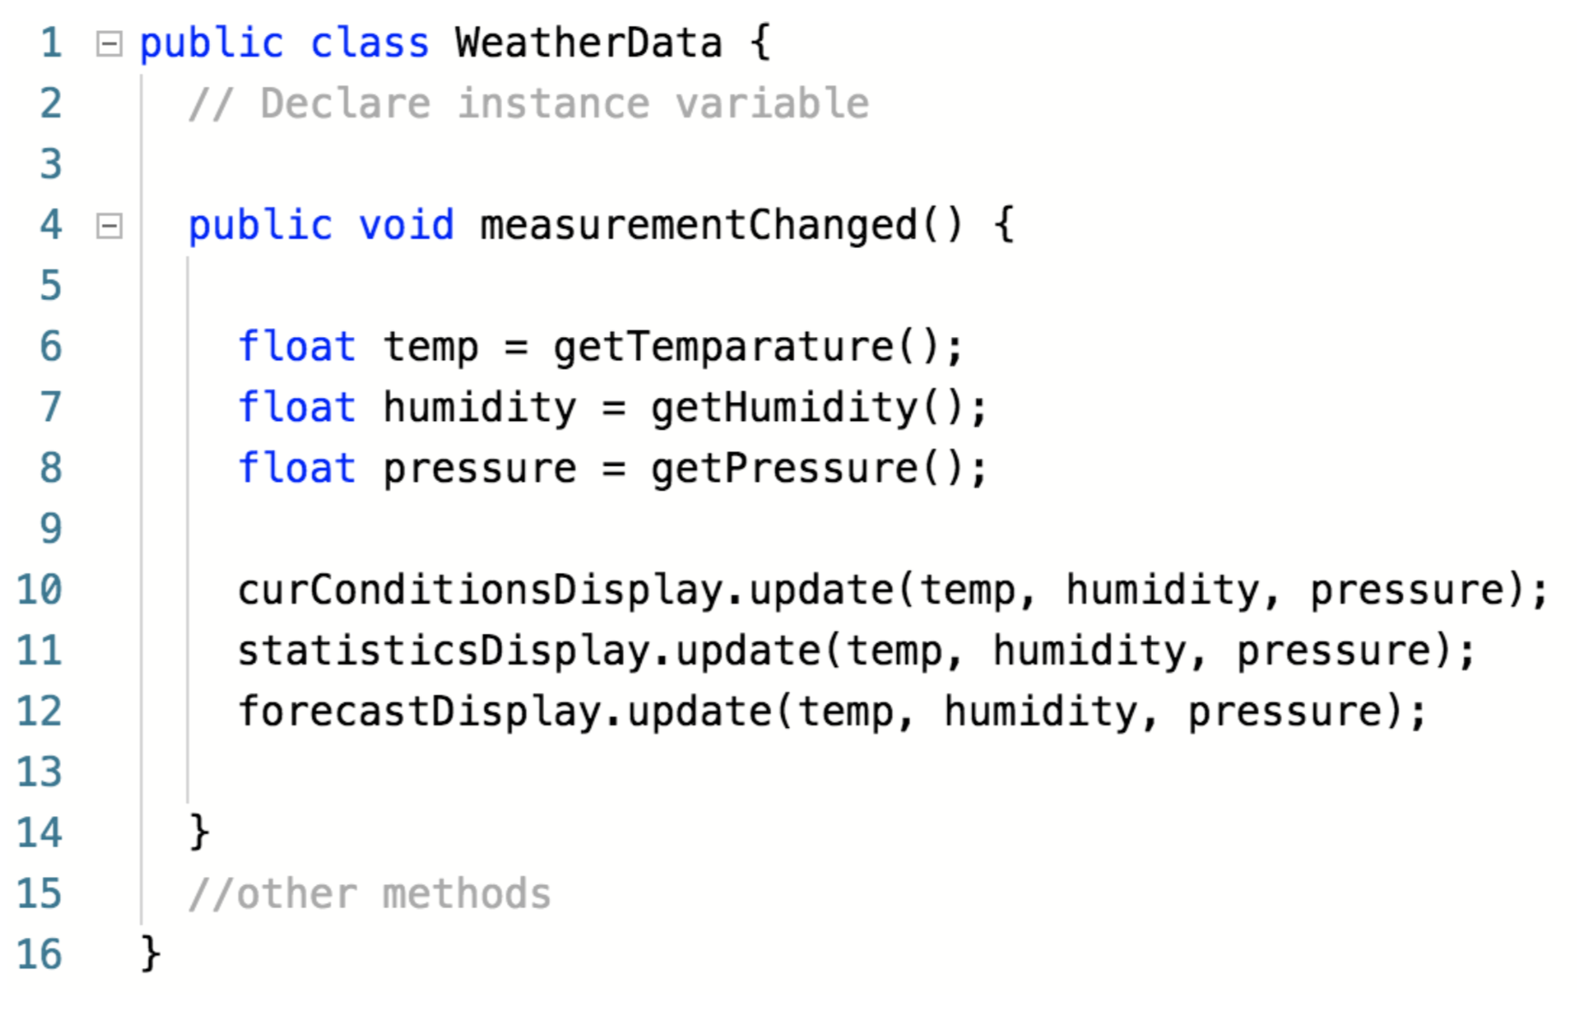
Weather Data Object

Slide 29
Identify the aspects of the application that vary

Slide 30
Identify the aspects of the application that vary
Which part of this method can vary?

Slide 31
Identify the aspects of the application that vary
Not changed

Slide 32
Identify the aspects of the application that vary
Not changed
Likely to be changed why?

Slide 33
Program to interface, not to implementation!
Current implementation is not reusable
Not changed
Likely to be changed

Slide 34
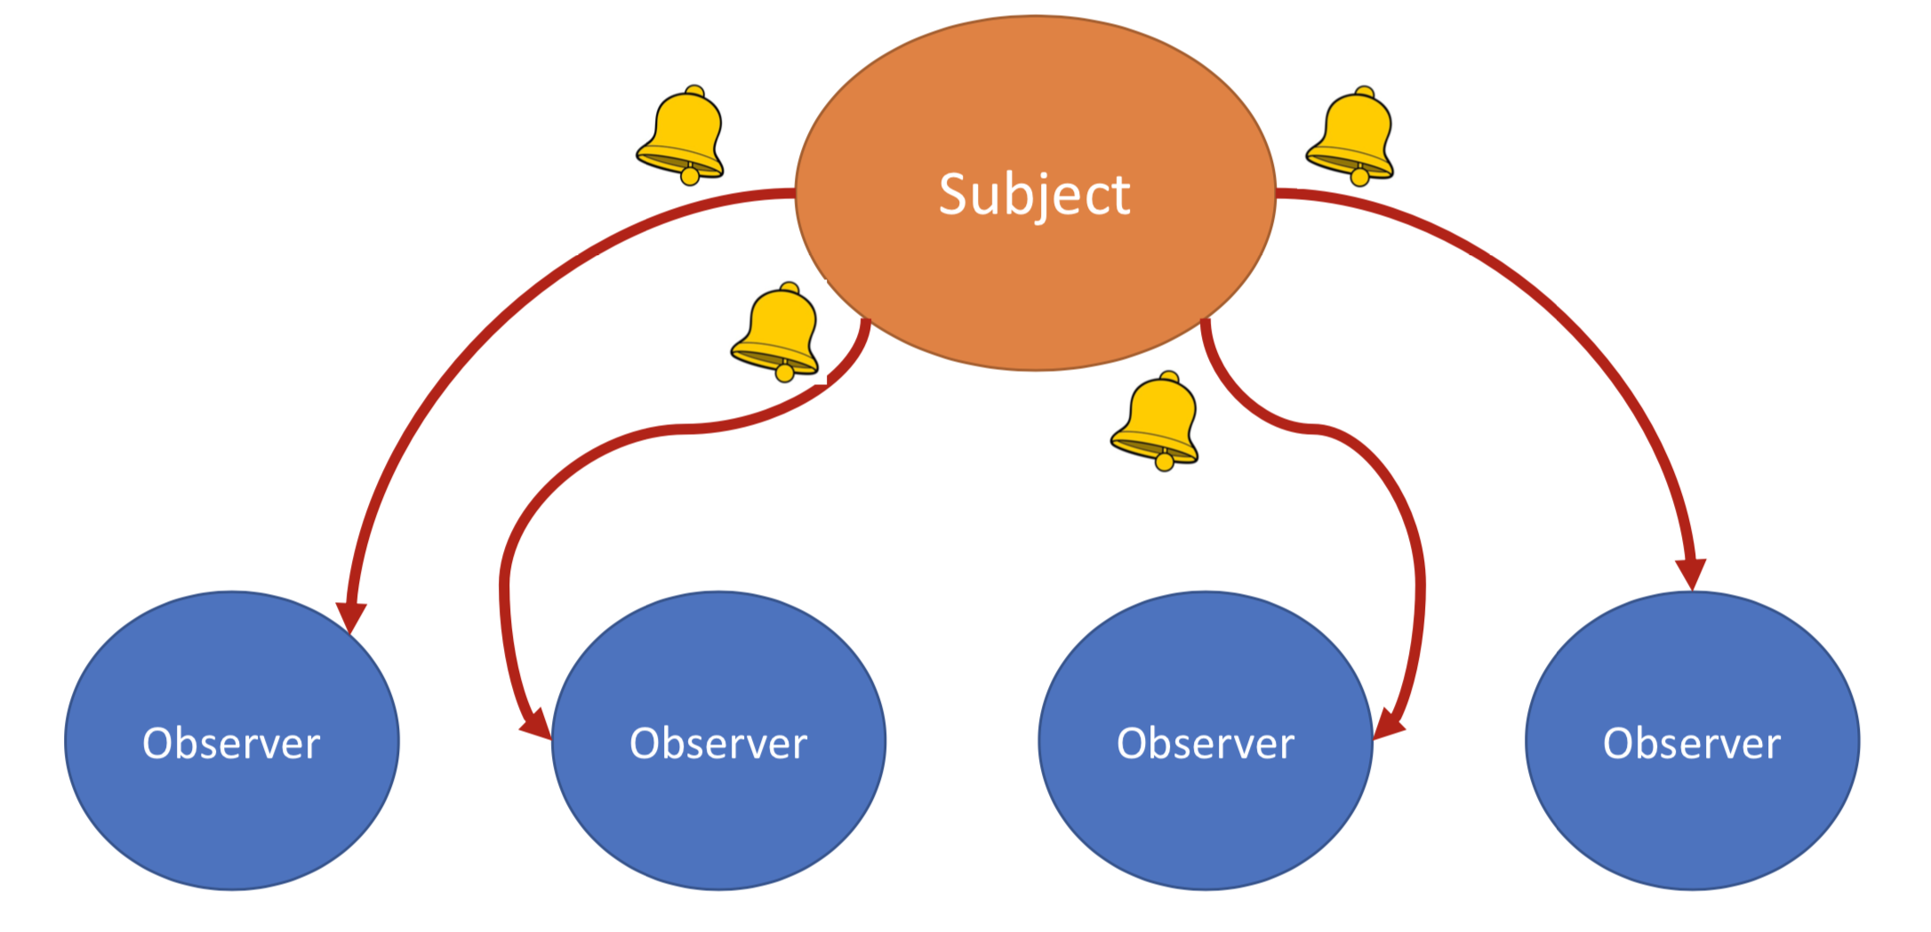
Observer Pattern
Notify observers of any events
Subject
Observer
Observer
Observer
Observer

Slide 35

Observer Pattern
Notify observers of any events
Subject
Observer
Observer
Observer
Observer
Observer pattern provides loose coupling

Slide 36
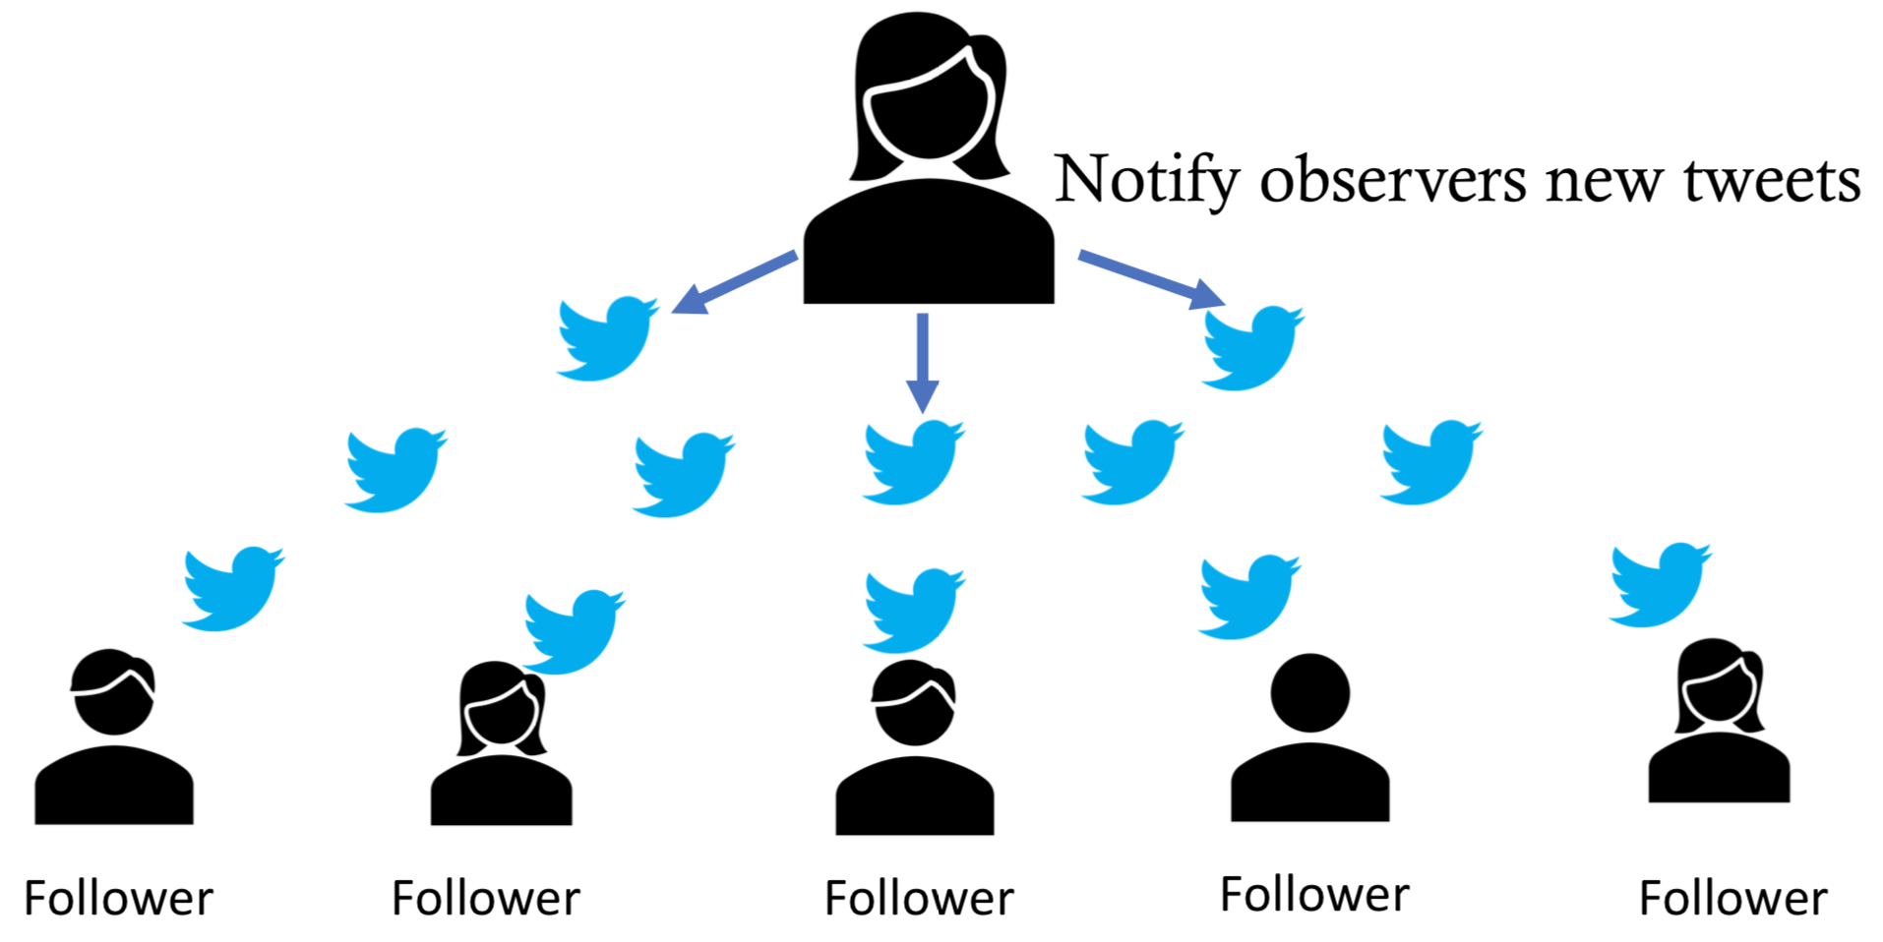
Observer Pattern

Slide 37
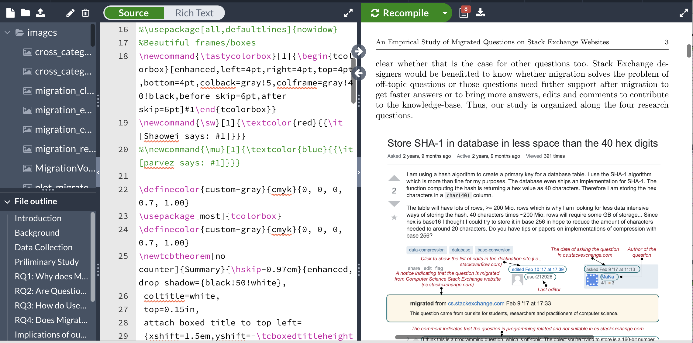
Observer Pattern
Latex Editor
Pdf Viewer

Slide 38
Observer Pattern
Notify any changes to observers
Observer

Slide 39
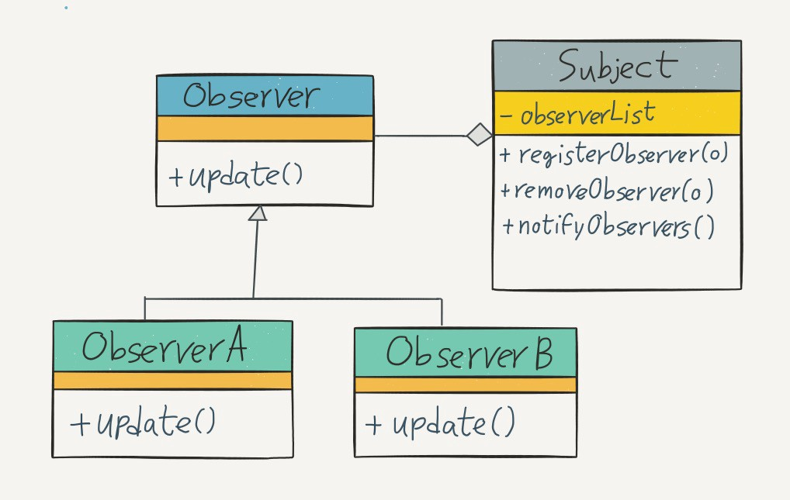
Observer Pattern

Slide 40
Let’s test the program

Slide 41
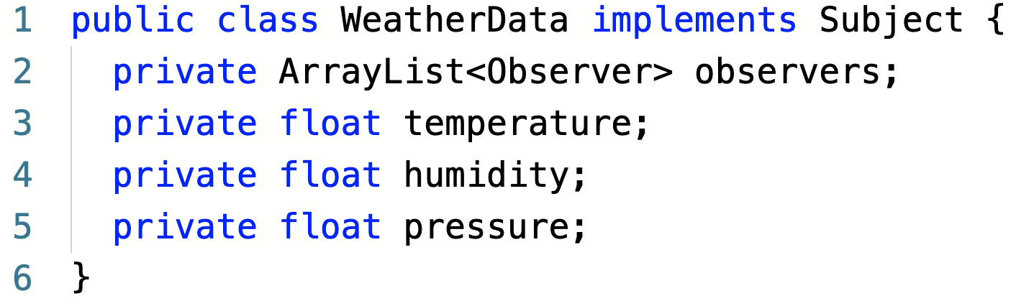
Using the Observer Pattern
Implements the Subject interface

Slide 42
Using the Observer Pattern
Maintains a list of Observers

Slide 43
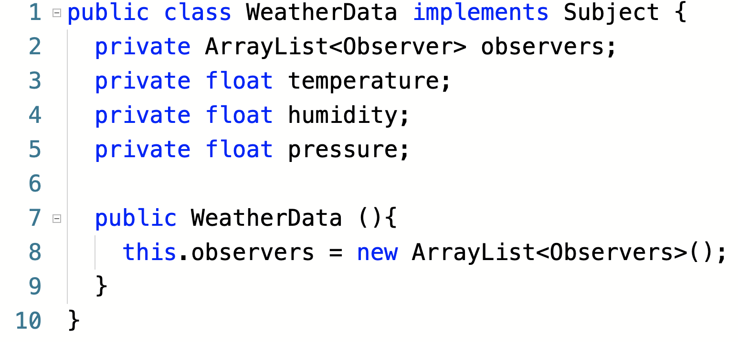
Using the Observer Pattern
Create a list that will contain the observers

Slide 44
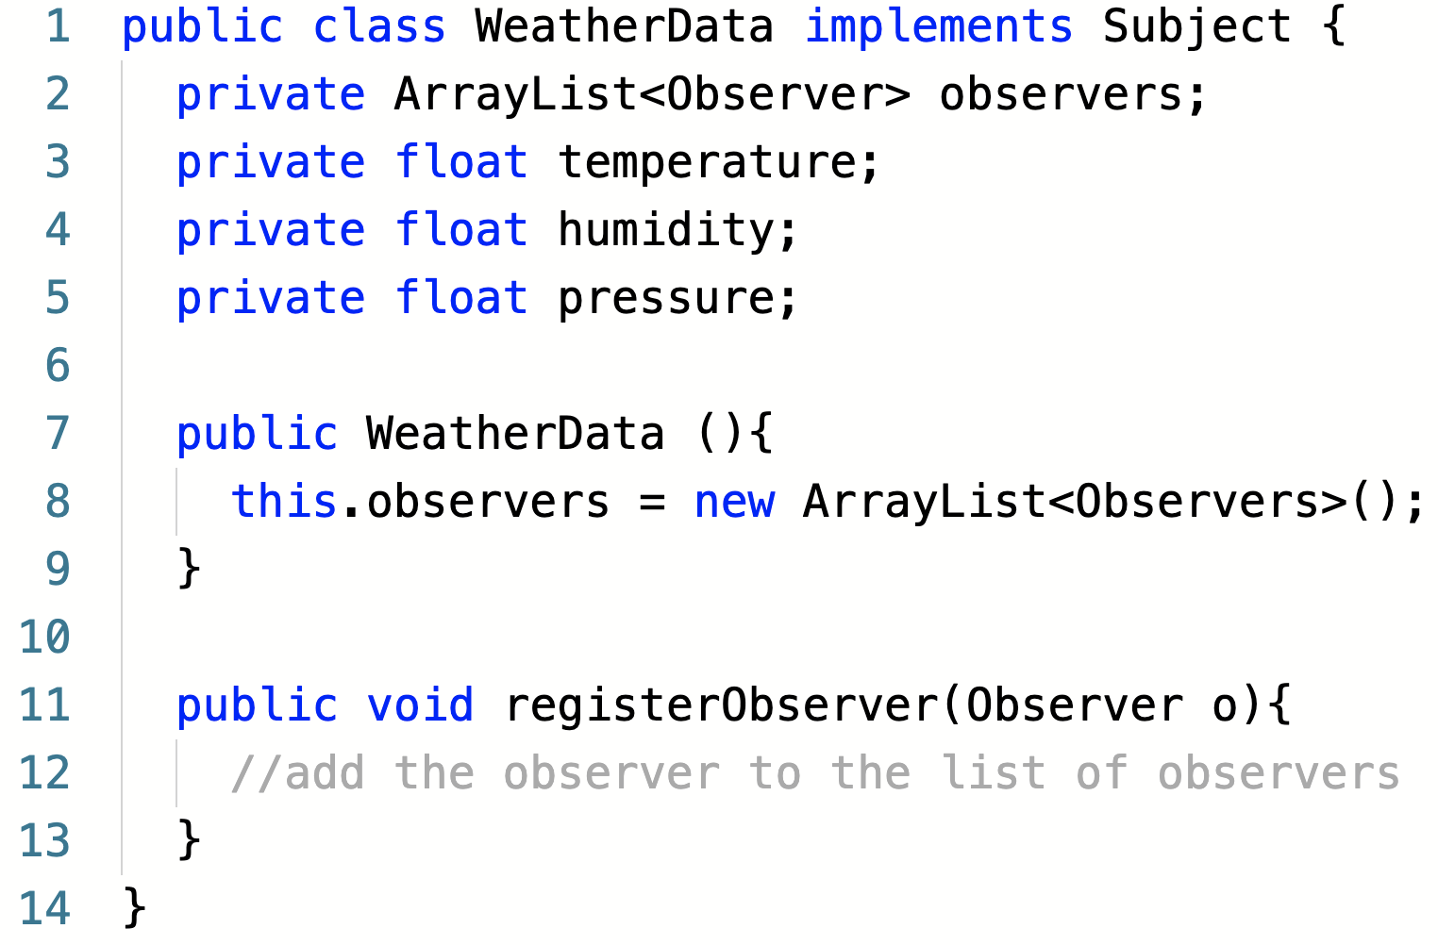
Using the Observer Pattern
Use the method to add an observer to the list

Slide 45
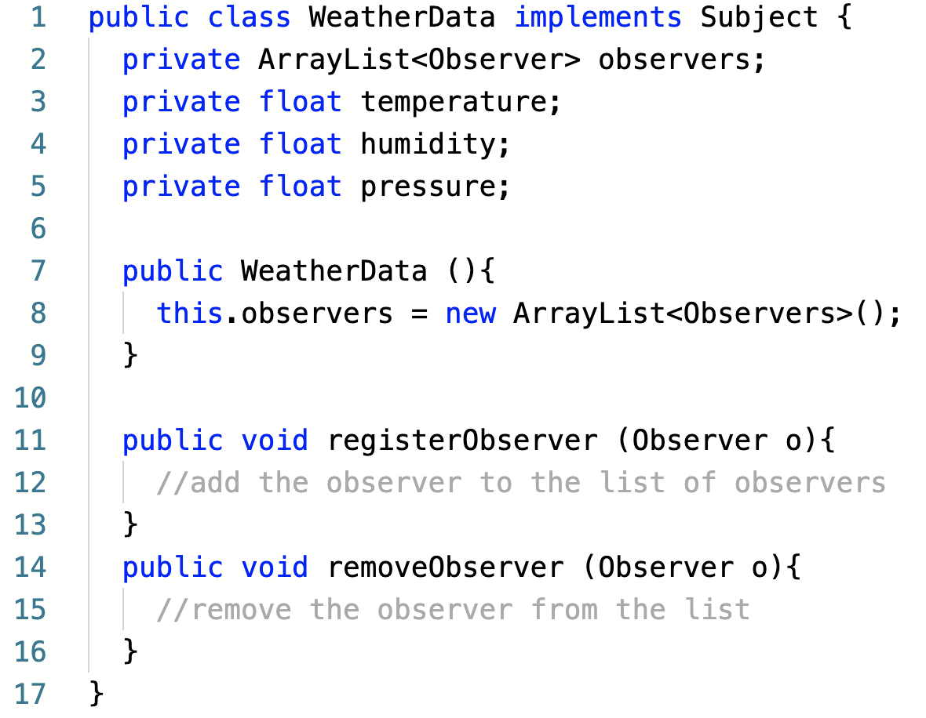
Using the Observer Pattern
Use the method to remove any observer from the list

Slide 46
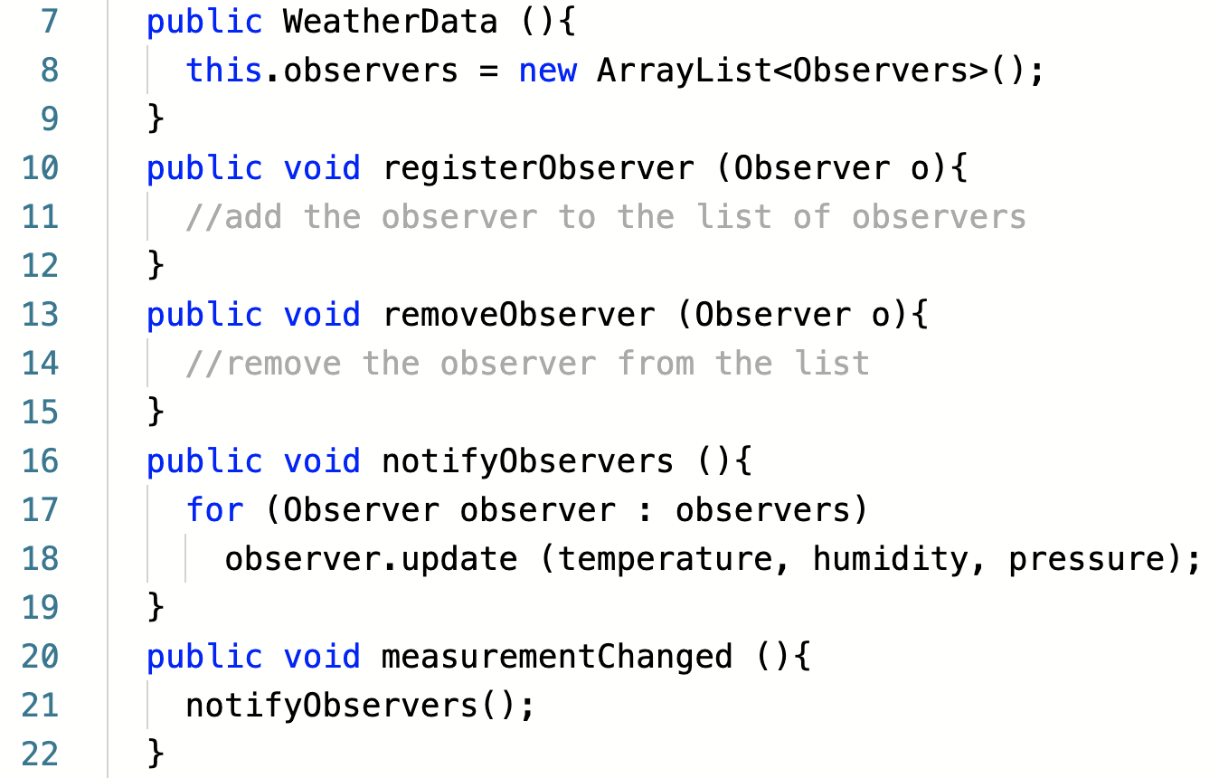
Using the Observer Pattern
Notify observers when any changes occur

Slide 47
Observer Pattern Support in Java
Import java.util.observable
Import java.util.observer

Slide 48
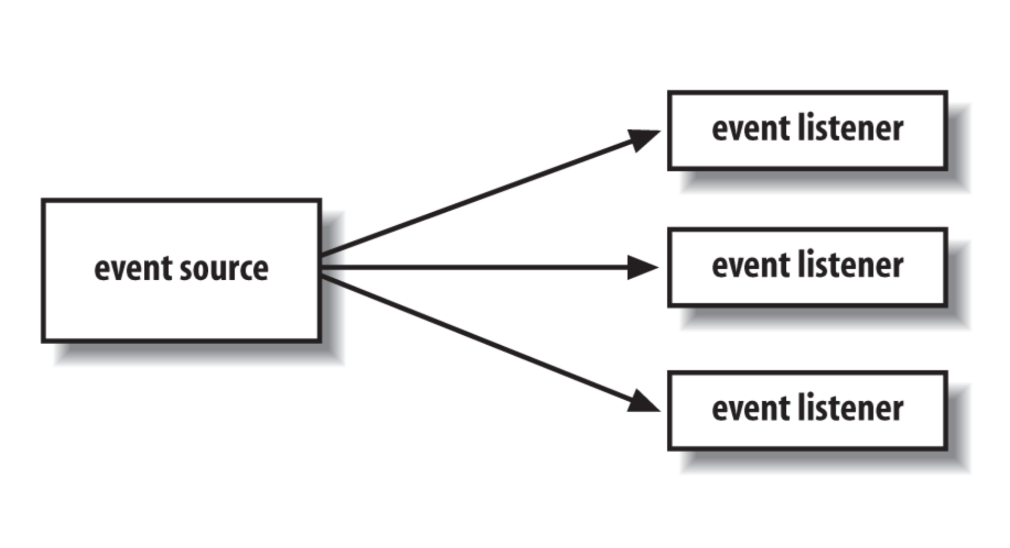
Examples of observer pattern in JDK

Slide 49
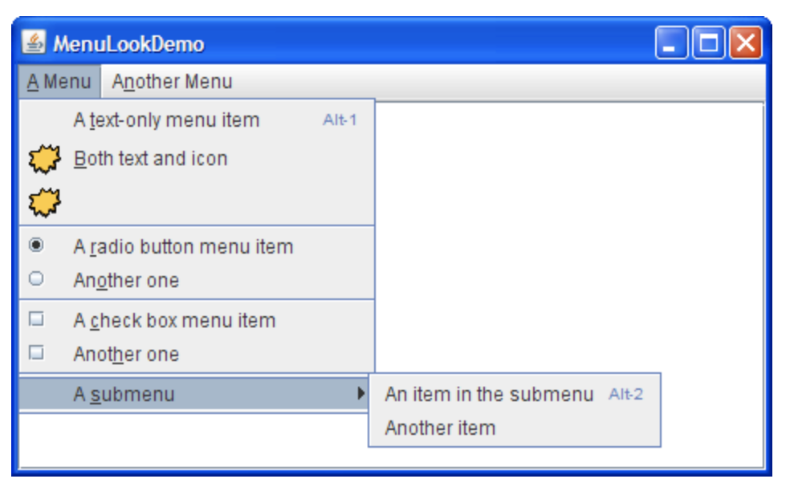
Examples of observer pattern in JDK
A menu item

Slide 50
Examples of observer pattern in JDK
Observers
Notify
Clicking on the menu item
will create an event

Slide 51
Tasks
Can you identify the advantages and disadvantages of using Java’s observable class or the observer interface?

Slide 52
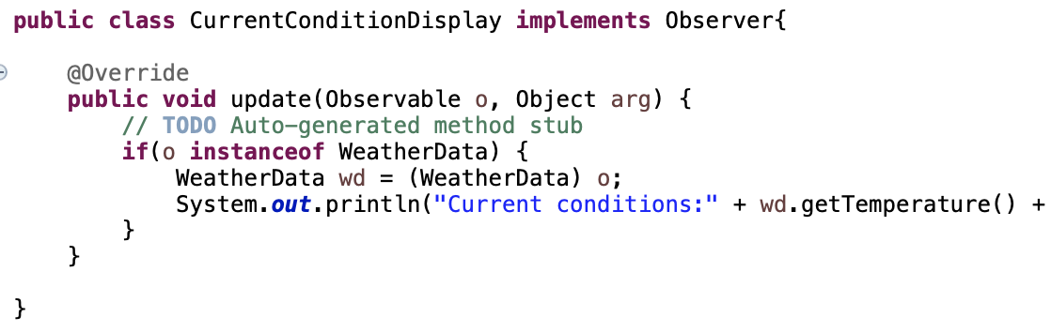
Tasks
Can you identify the advantages and disadvantages of using Java’s observable class or the observer interface?
Can you identify any design issues in the above code? How can we fix that?

Slide 53
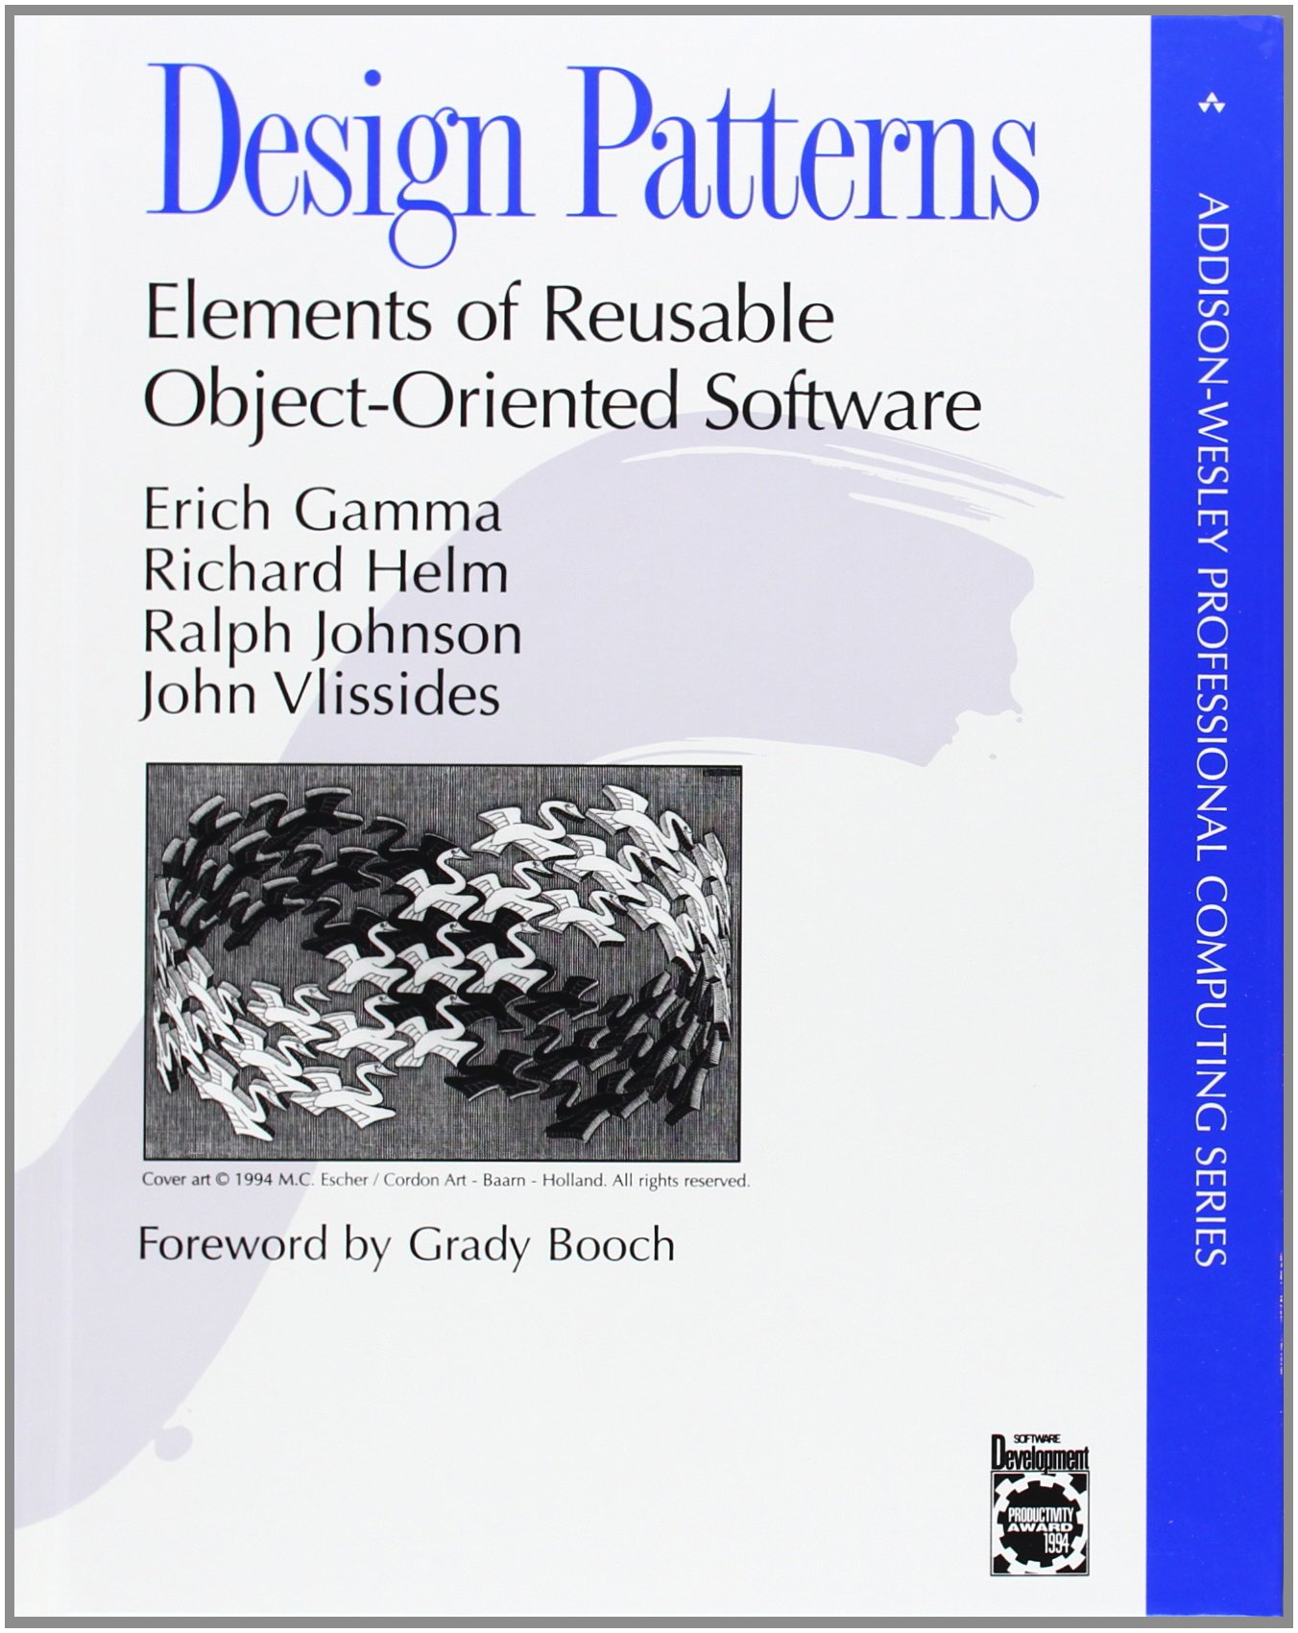

Resources
https://github.com/parvez2014/ObserverPatternCustomTutorial
https://github.com/parvez2014/ObserverPatternJDKTutorial

Slide 54
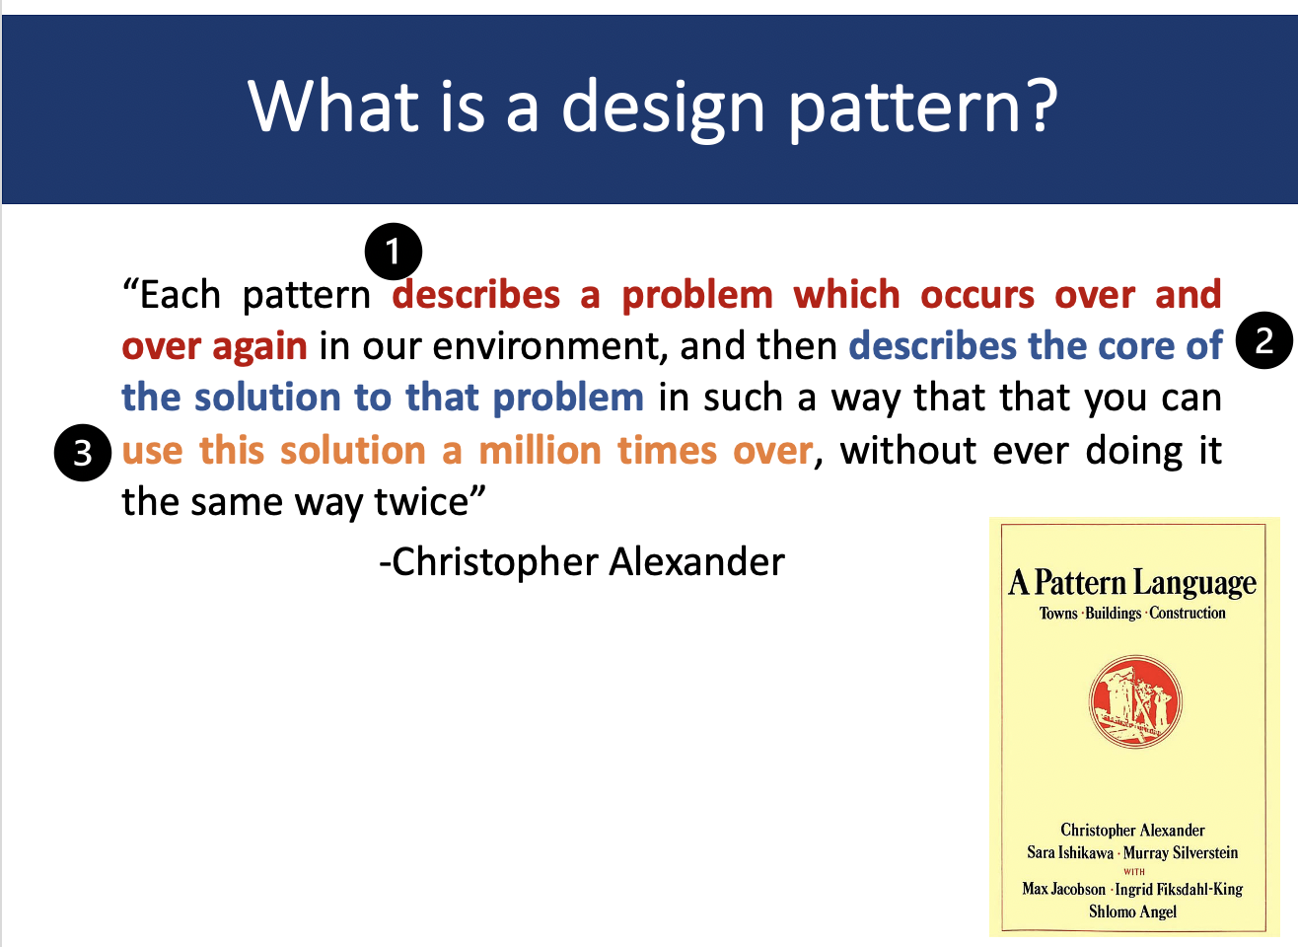

Slide 55
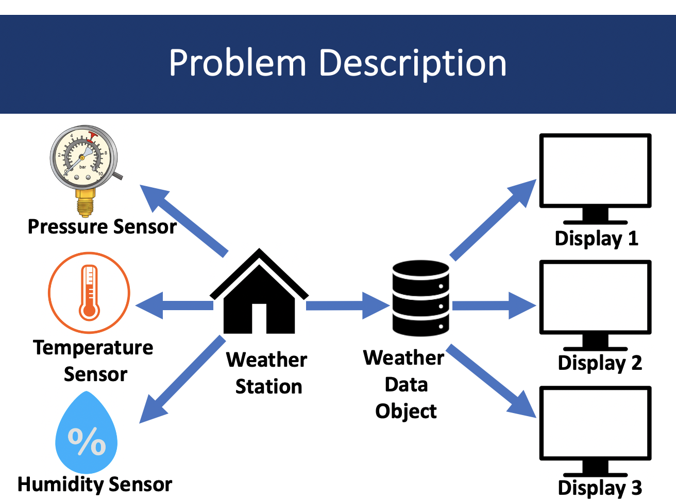

Slide 56
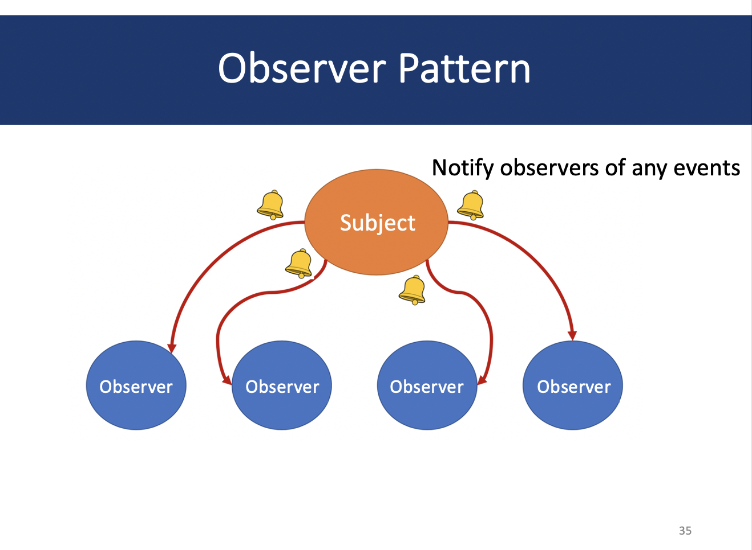

Slide 57
